Slide 1

DEPI FOR ONLINE COURSES
Unlock your potential with our expert-led online courses – learn anytime, anywhere, and take the next step in your journey to success!

Slide 2
Brief description of the project:
This online platform offers a seamless learning experience, providing users the ability to explore, enroll in courses, and engage with interactive educational content at their own pace. The key features of the platform are designed to enhance the learning process for students and simplify administrative tasks for course managers.

Slide 3
Features:
Course Management: Users can browse a wide range of available courses in various subjects. Each course comes with detailed descriptions, lesson plans, and instructor profiles to help students make informed decisions.

Slide 4
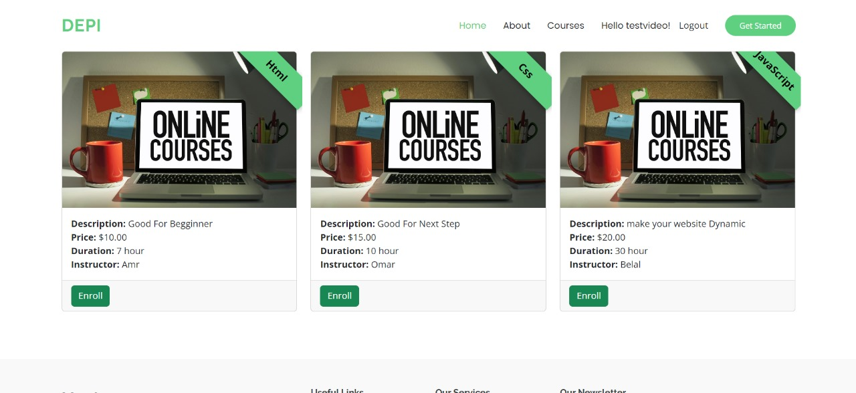
Onclick on Enroll Button

Slide 5
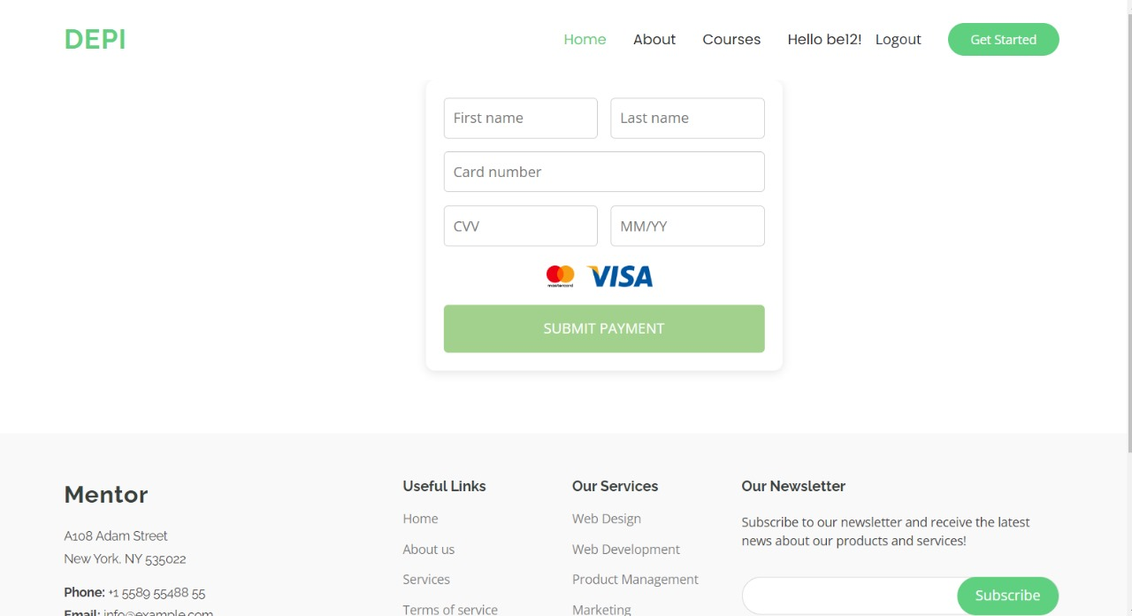
Enroll Data of Visa Card

Slide 6
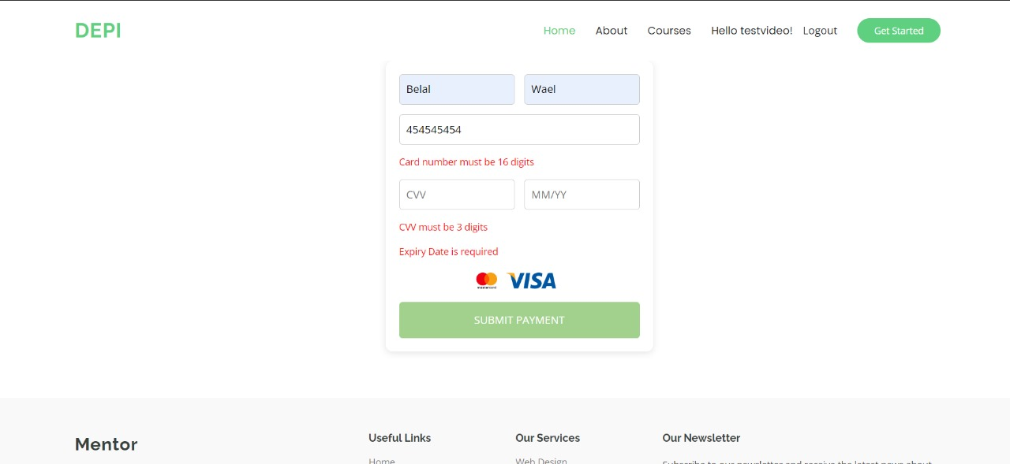
Error Handling for Empty Visa Card Data In our platform, when a user attempts to submit payment information with an empty or incomplete Visa card field, the system will display an error message and prevent form submission. This ensures that all required payment details are provided accurately, enhancing both user experience and security.

Slide 7
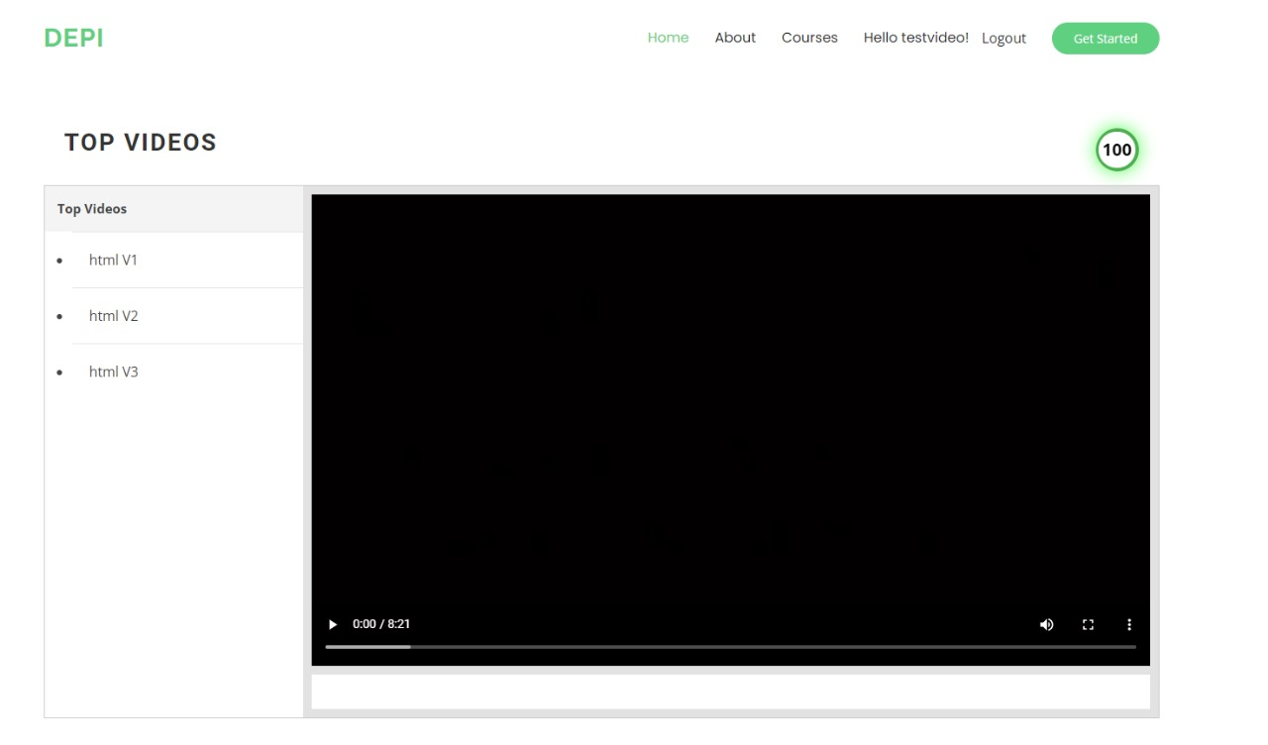
Successful Enrollment and Course Access Once a user successfully submits their Visa card details and the payment is processed, they will be automatically enrolled in the selected course. Immediately after enrollment, the user will gain access to all lessons within the course. They can now begin studying and track their progress, allowing them to move through the course at their own pace and see their completion status as they advance.

Slide 8
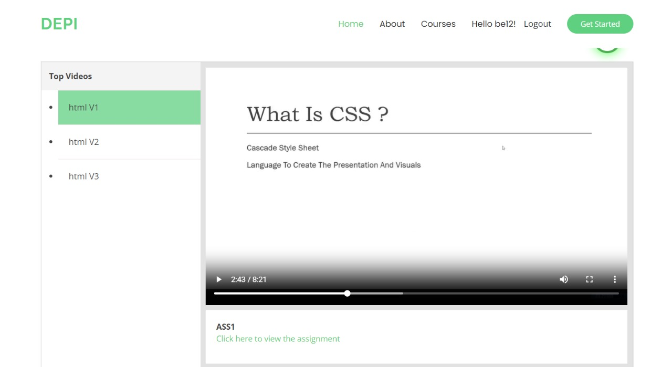
Assignment Access As the user progresses through the course, they will also gain access to any related assignments for each lesson or module. These assignments are designed to reinforce learning and assess their understanding of the material. Tracking their assignment progress further contributes to their overall course completion status.

Slide 9
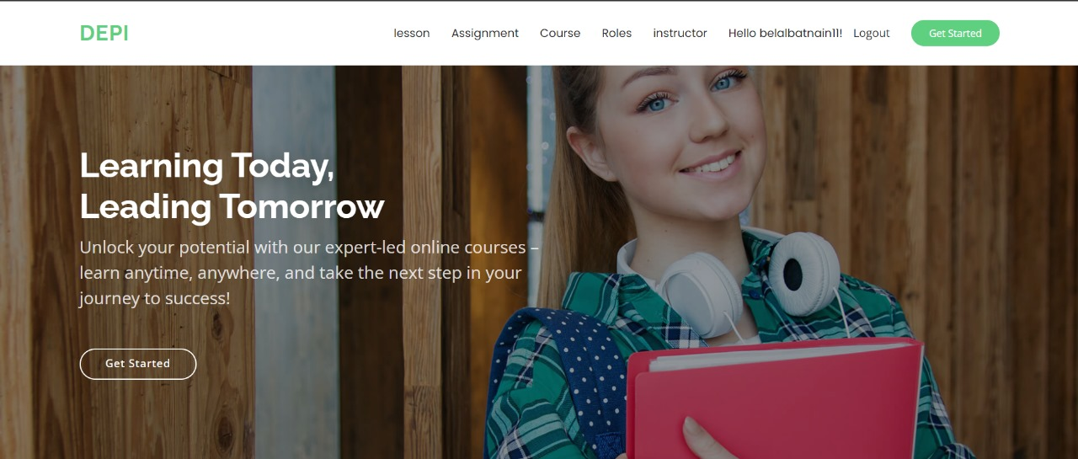
Admin Dashboard Management When logged in with a specified admin account, the user gains access to a comprehensive admin dashboard. This interface allows the admin to perform a wide range of tasks, including adding, updating, and deleting data related to courses, lessons, and instructors. Additionally, the admin can manage user roles, assigning or modifying accounts to designate them as students, instructors, or super admins. The super admin role grants full control over the platform, enabling management of all aspects of the website, ensuring smooth operation and effective organization of content and users.

Slide 10
made by:
Amr Hafz
Balal Wael
Omar Ebada
Mohamed Zain
Special thanks to: Eng. Reham Osama and (DEPI) for their support.

